Slide 1
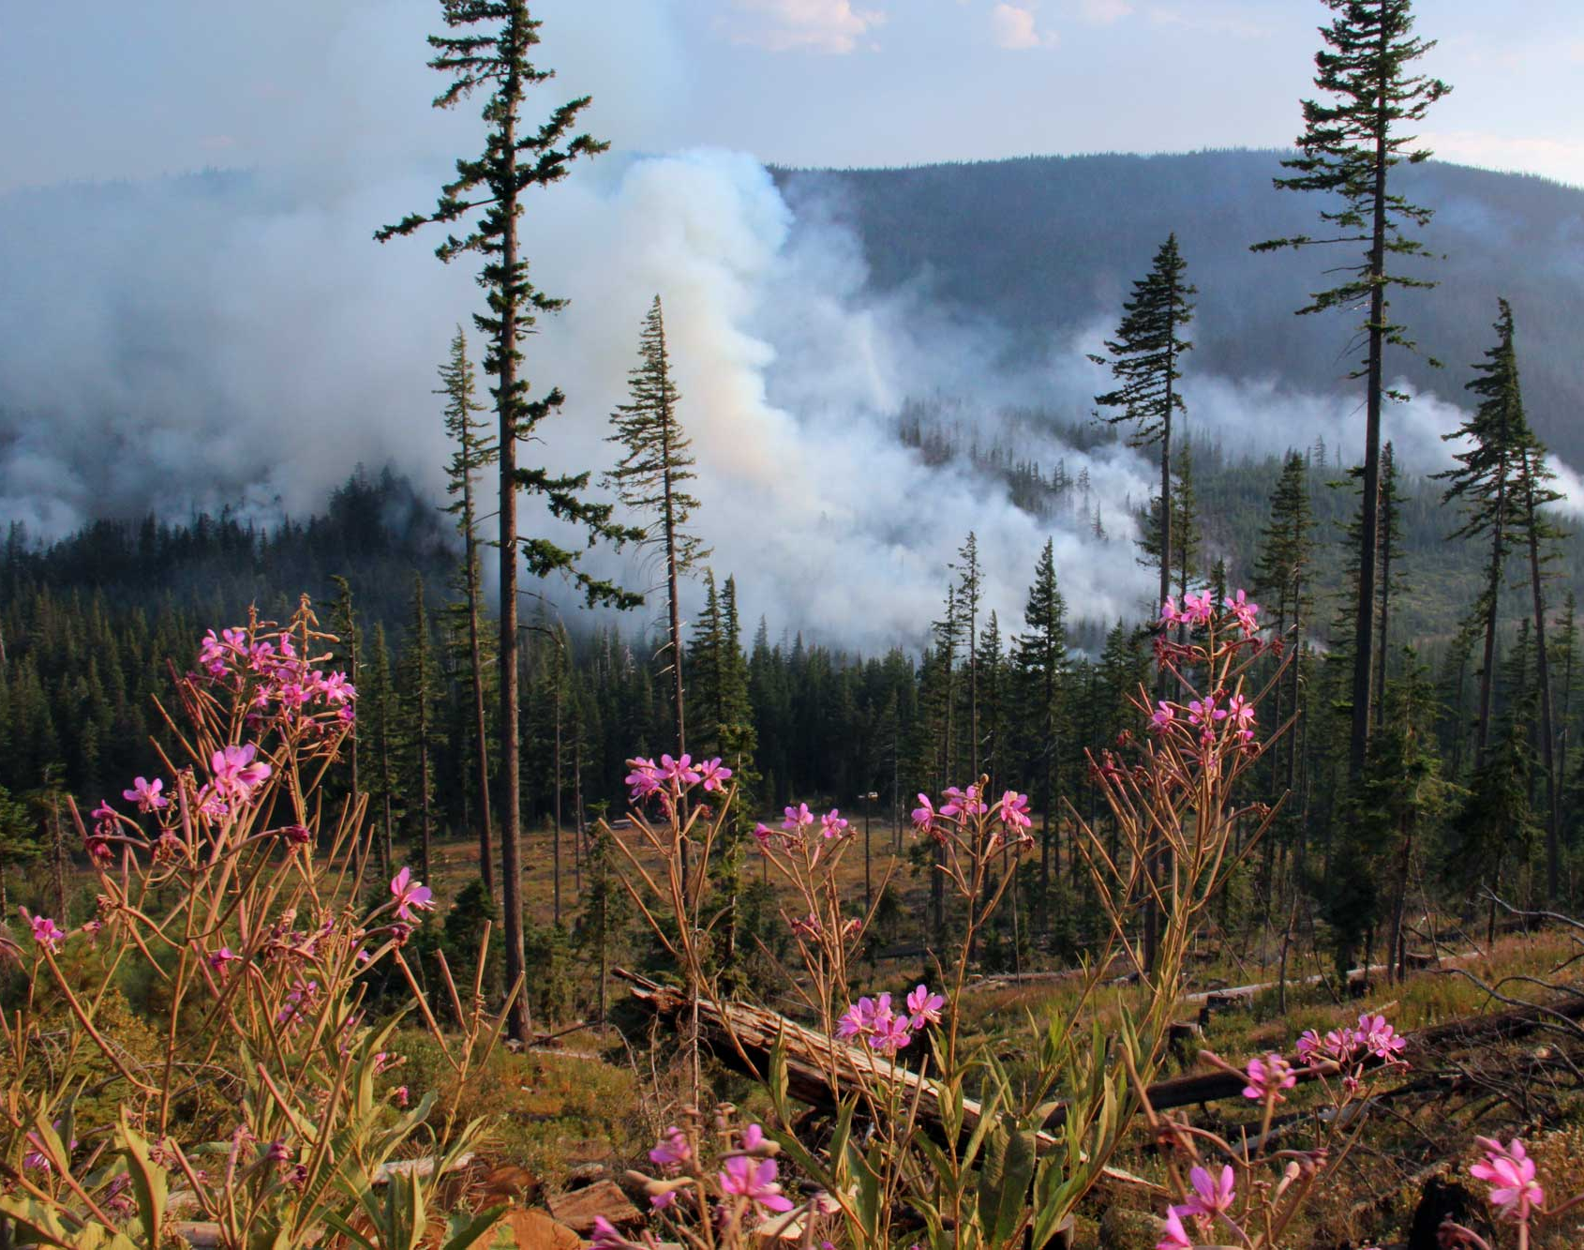
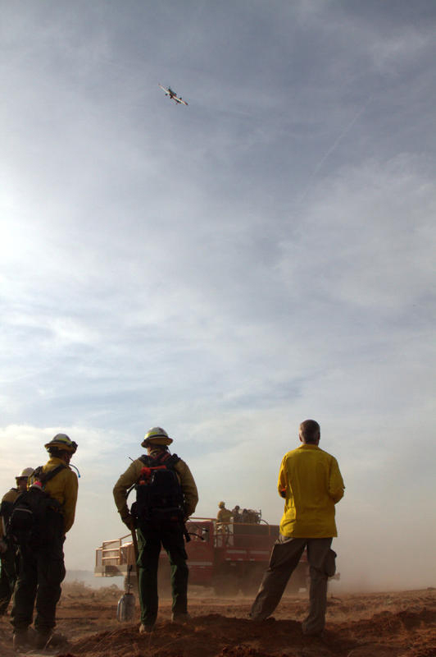
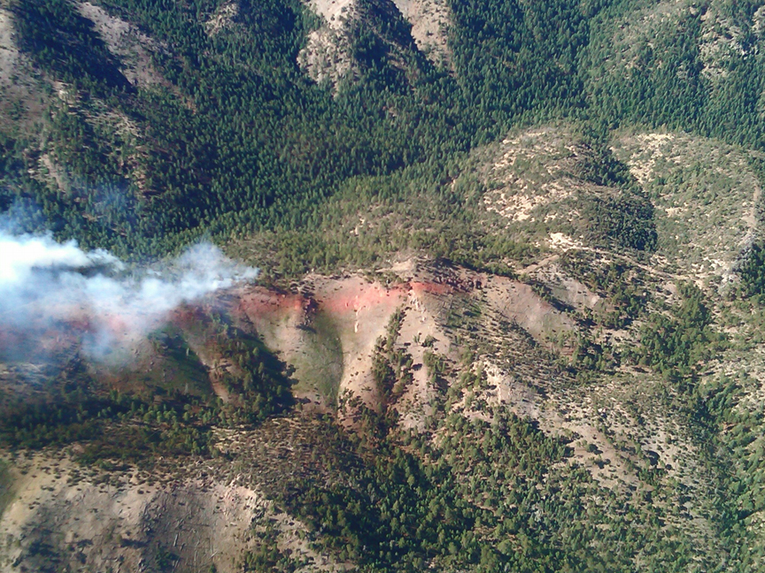
Using Science to Inform policy: A Cohesive Strategy for Wildland Fire Management
Danny C. Lee
Director
Eastern Forest Environmental Threat Assessment Center
USDA Forest Service

Slide 2
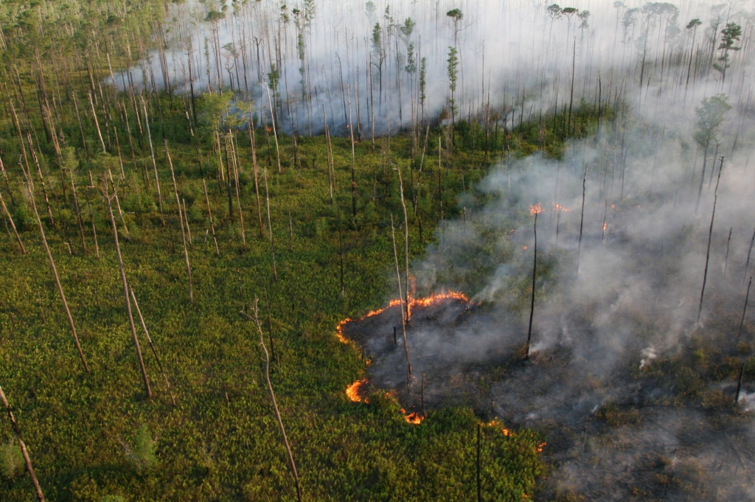
What is the Cohesive Strategy?
(the National Cohesive Wildland Fire Management Strategy )
A national, collaborative approach to addressing wildland fire across all lands and jurisdictions
Developed with input from wildland fire organizations, land managers and policy-making officials representing multiple levels of governmental and non-governmental organizations

Slide 3
Vision
“Safely and effectively extinguish fire, when needed, use fire where allowable; manage our natural resources; and as nation, live with wildland fire.”

Slide 4
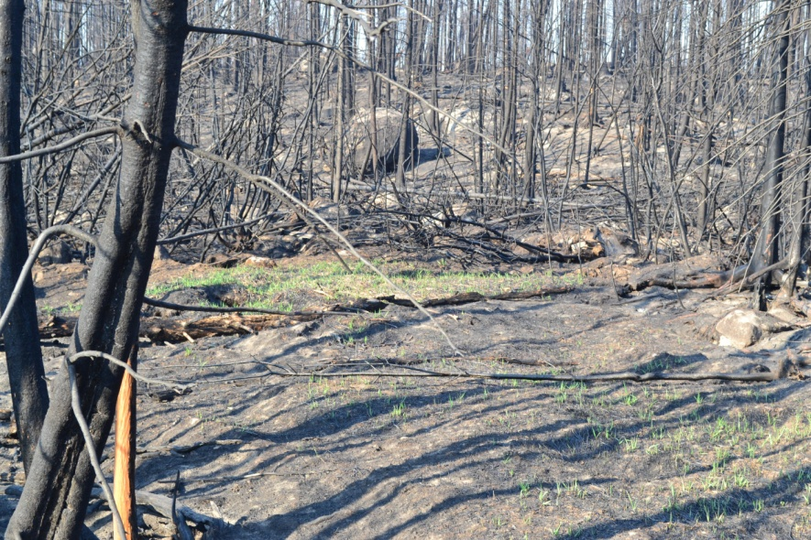
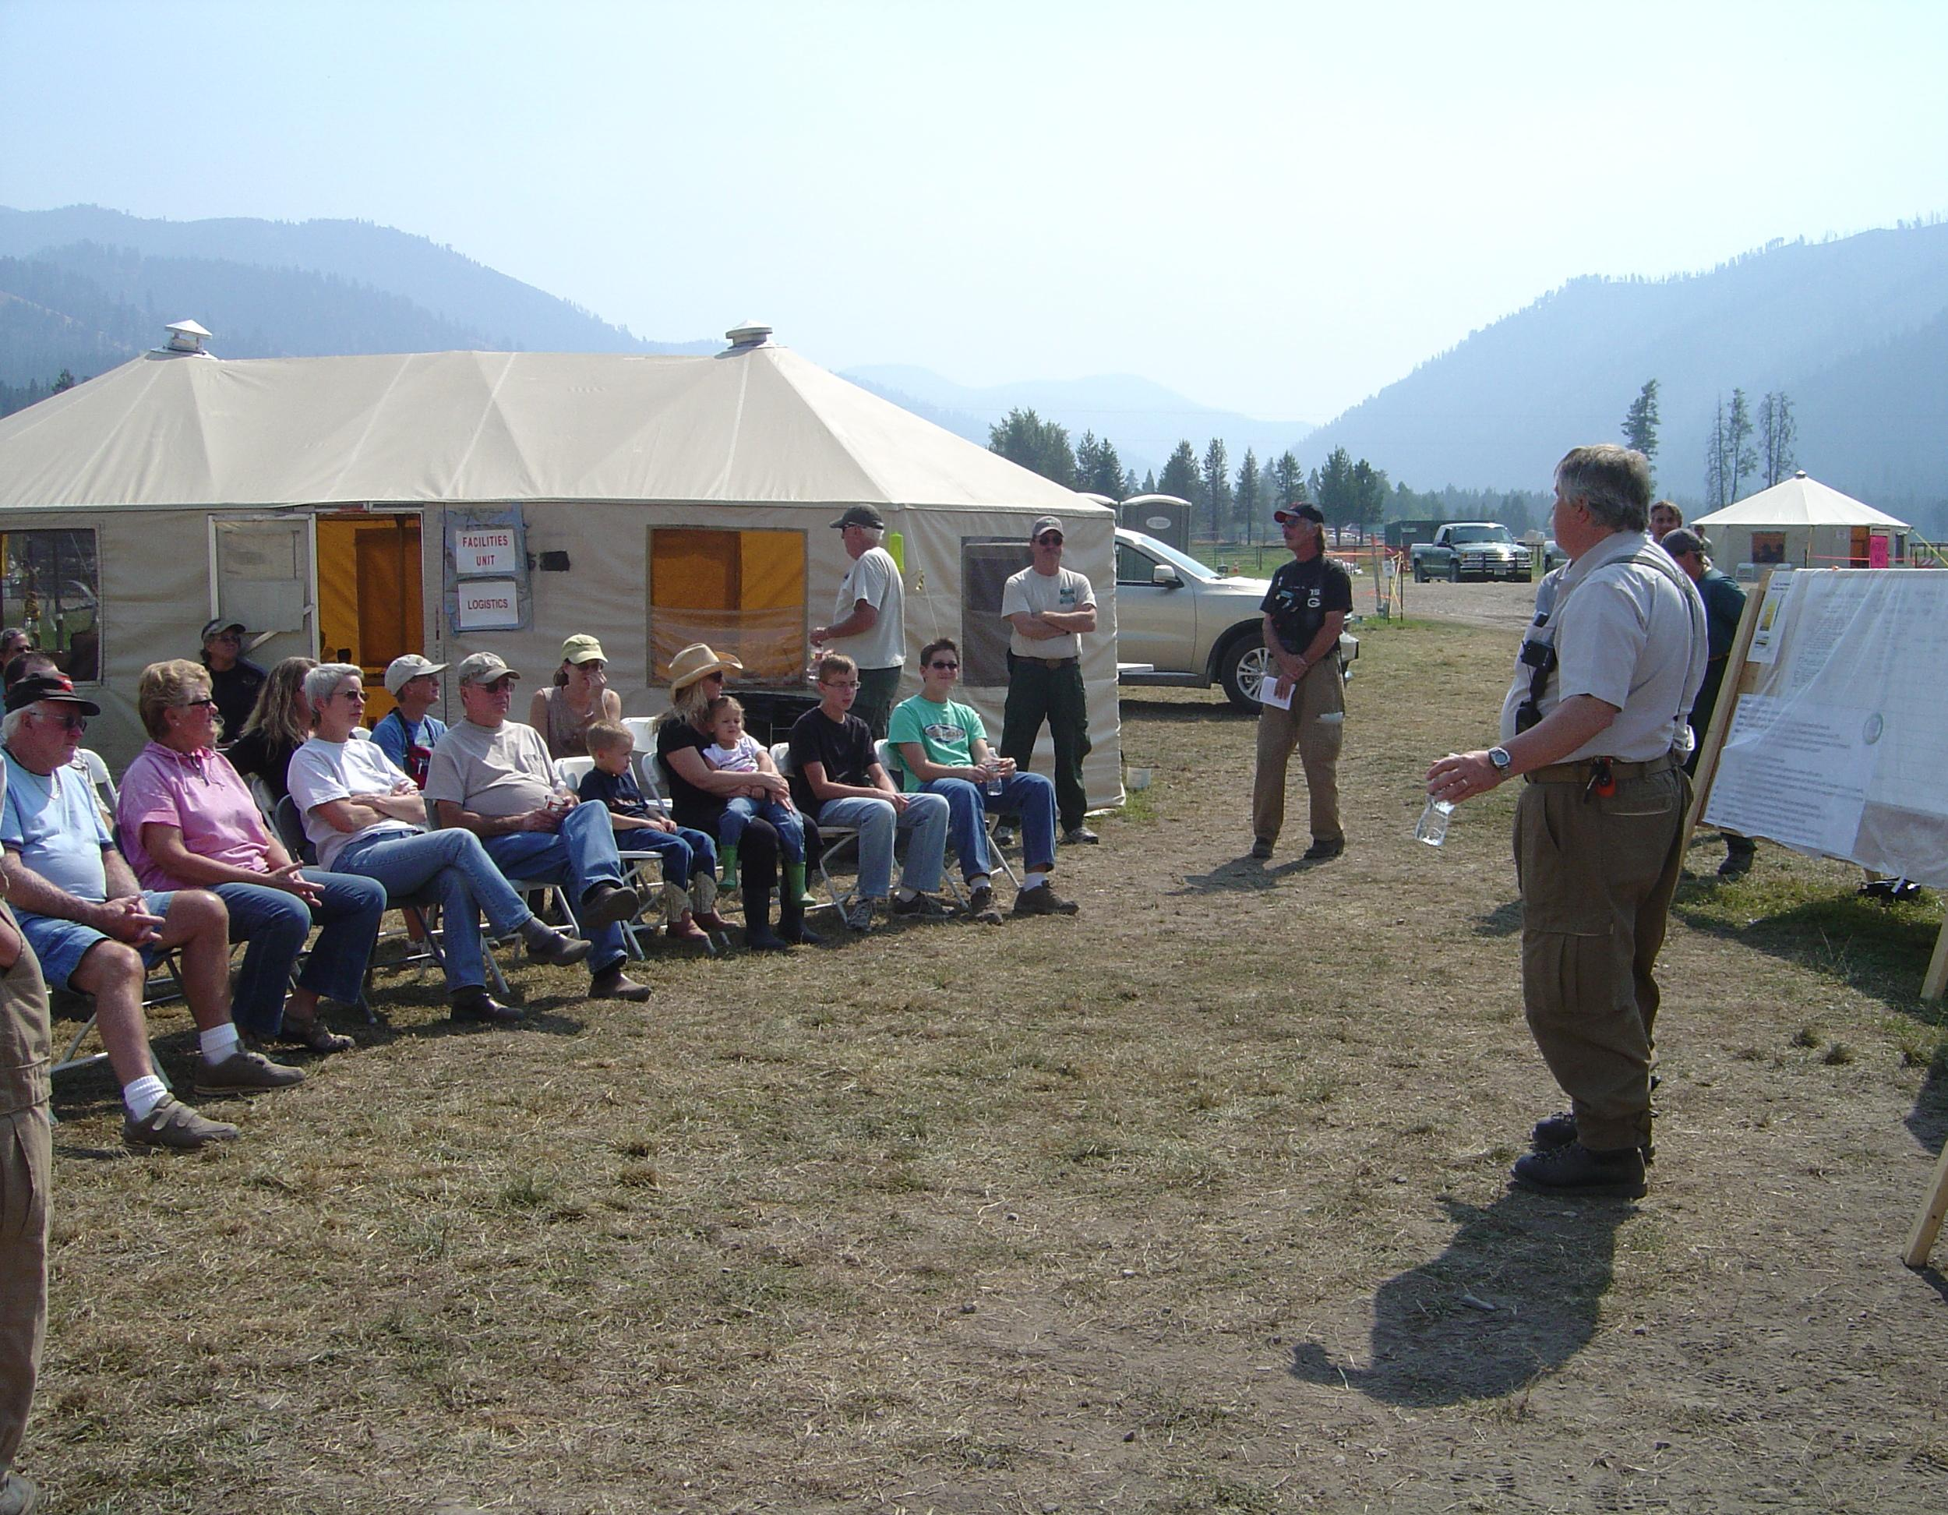
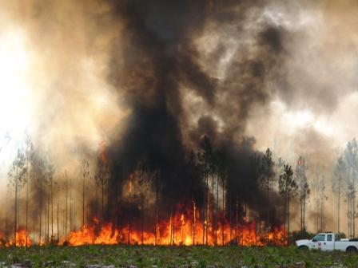
Cohesive Strategy Focus Areas:
Restore and maintain resilient landscapes
Fire adapted communities
Response to wildfire
Notes:
The goals of the Cohesive Strategy are to ensure:
Landscapes across all jurisdictions are resilient to fire-related disturbances in accordance with management objectives
Human populations and infrastructure can withstand a wildfire without loss of life and property, and
All jurisdictions participate in making and implementing safe, effective, efficient risk-based wildfire management decisions

Slide 5
Comparative Risk Assessment Process
Specify Objectives
Analysts & Scientists
Design Alternatives
Model Effects
Managers & Stakeholders
Synthesize Results
Notes:
Reminder that the Cohesive Strategy has been using the CRAFT process in the design and analysis of alternatives and that different teams have had different responsibilities within this process.

Slide 6
1. Objective: Build and maintain landscape resiliency.
  1.1 Contributing Objective: Restore and maintain desired species, vegetative structure and composition, or fuel conditions.
    1.1.1 Action: Utilize naturally ignited wildfires (wildfire for beneficial effects).
    1.1.2 Action: Use prescribed fire over large contiguous landscapes.
  1.2 Contributing Objective: Reduce wildland fuels in areas that will facilitate tactical defense of human communities or ecological values and services from wildfire (create tactical fuel breaks).
    1.2.1 Action: Primarily rely on mechanical treatments.
    1.2.2 Action: Use prescribed fire in limited circumstances.
Notes:
Completing an objectives hierarchy was one of the primary exercises completed by the RSC’s during Phase 2.

Slide 7
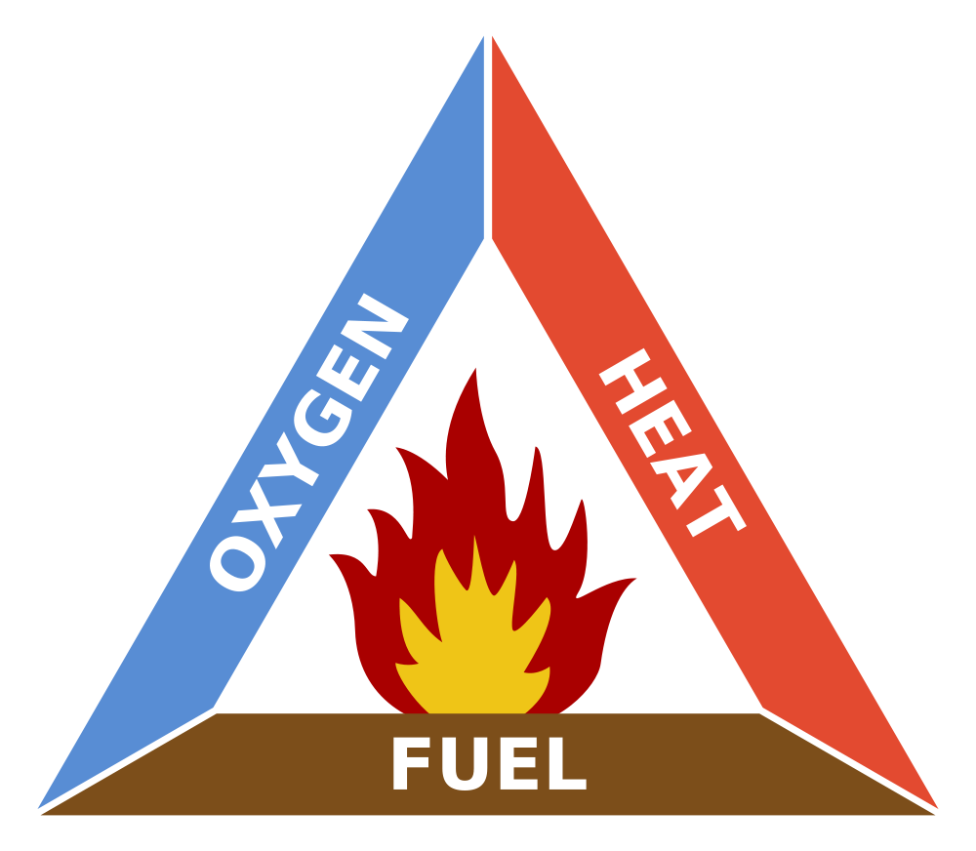
Fundamental Components of Fire

Slide 8
Conceptual Model of Wildfire
Prevention
Programs
Fuel Treatments
Ignition
Weather
Fuels
Fire Extent
& Intensity
Topography
Suppression
Response
Response Capacity
Consequences
(Loss & Gain)
Reduce Exposure
Notes:
Conceptual model that really shows (in red) what some of our options are to impact fire and its impacts.

Slide 9
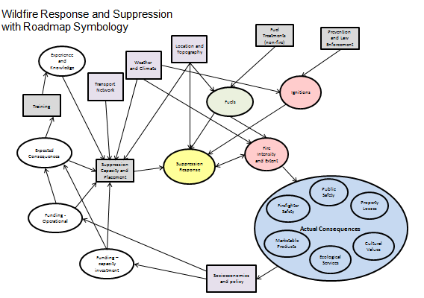
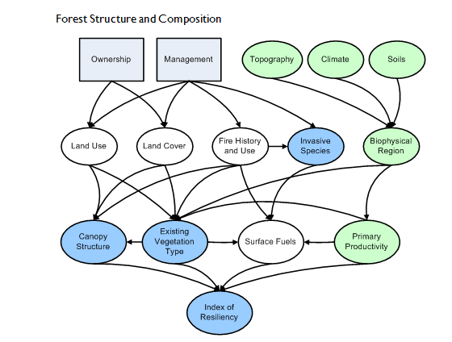
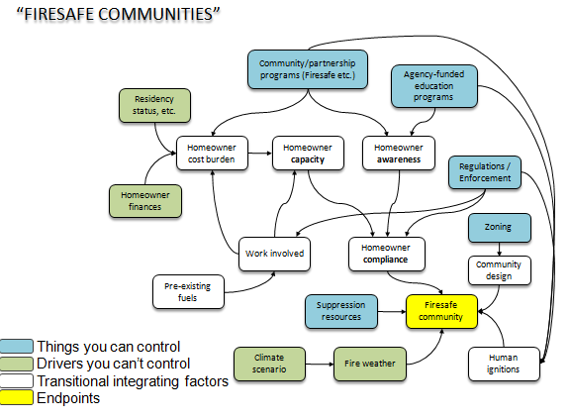
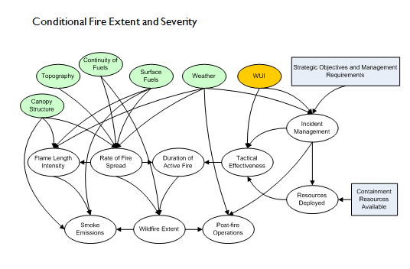
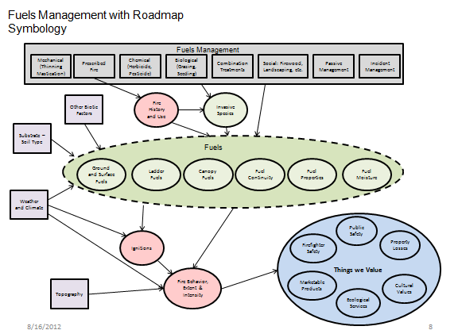
Numerous Conceptual Models
Notes:
Many more detailed conceptual models were created by the science team and shared with the RSC’s.

Slide 10
Basic Structure
Actions and Activities
(decision variables)
Contributing Factors (predictor variables)
Measures
of Risk
(response variables)

Slide 11
General Categories of Data
Biophysical
  Precipitation and Temperature
  Terrain (elevation and slope)
  Potential and Existing Vegetation
Social and Economic
  Demographic information (from census)
  Urban influence (population and proximity)
  Wildland-Urban interface
  Land-use or other measures of economic activity

Slide 12
General Categories of Data
Wildland Fire
  Capacity (stations, equipment, and personnel)
  Frequency and extent
  Causes of ignitions
  Human safety (injuries and fatalities)
  Property loss

Slide 13
Dimensional Reduction Techniques
There are many variables that can be (and have been) measured to describe all of the various aspects contributing to wildland fire. So many, in fact, that it is not practical to use them all directly within an analytical model.
Dimensional reduction techniques are statistical methods that start with many variables and try to identify a smaller set of derived variables (super variables) that can efficiently describe the variation within the data.

Slide 14
Analytical Approach
Influence Diagrams, a.k.a. Bayesian Belief Networks
  Used to show causal relationships among decisions (actions), random variables, and end values.
  Uses conditional probability and probabilistic modeling to quantify relationships.
  Highly flexible.

Slide 15
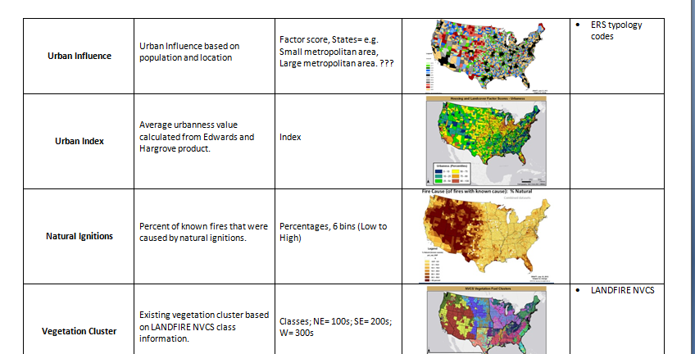
Crosswalk of Data to Nodes
Notes:
This is one of the hand-outs.

Slide 16
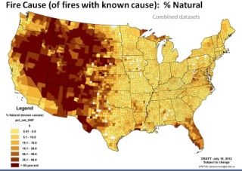
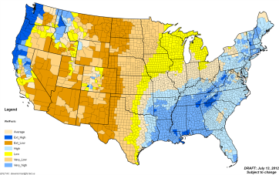
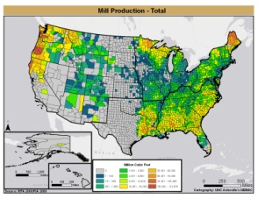
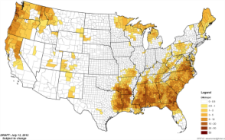
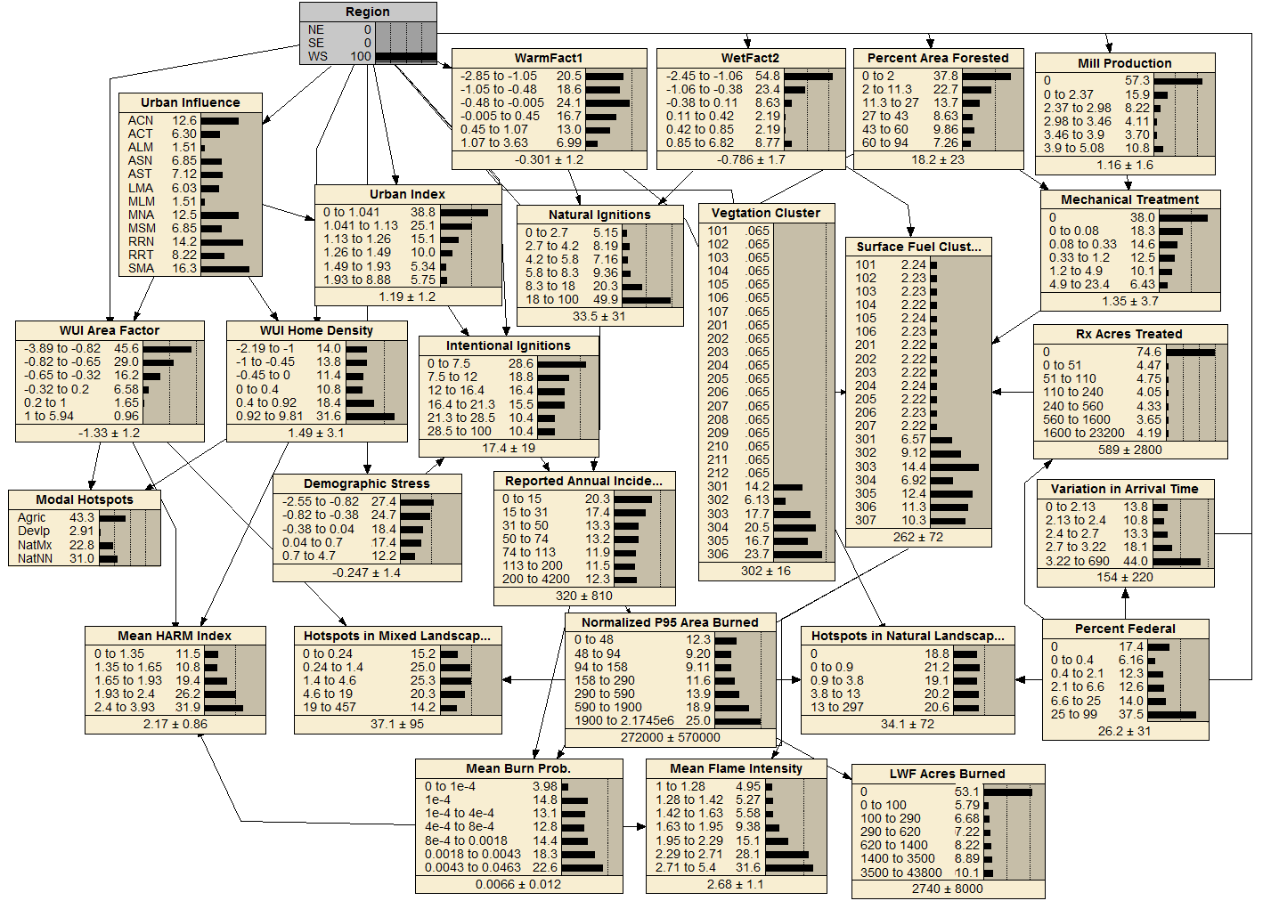
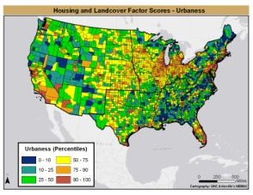
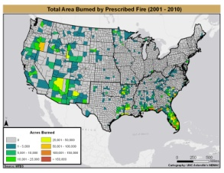
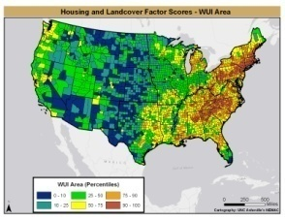
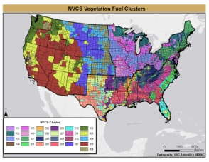
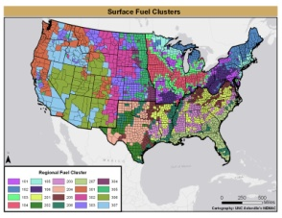
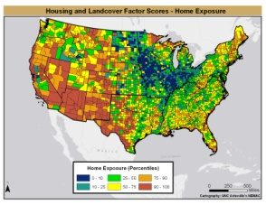
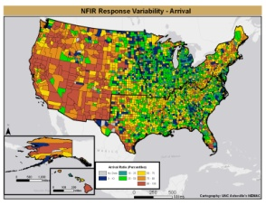
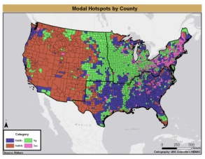
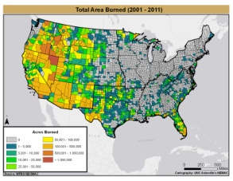
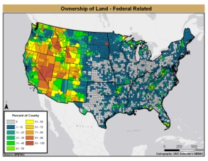
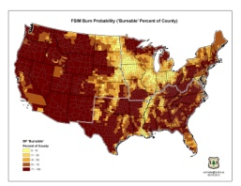
High percentage of natural ignitions
Relatively dry
Low mill production
What makes the West unique?
Less mechanical treatment
Less urban
Less prescribed fire
Small proportion of landscape in the WUI/intermix
Six classes of vegetation
Seven classes of fuels
Large proportion of homes in the WUI/intermix
Fires occurring in natural environments
Flame Intensity
High percentage of acres burned
Longer arrival times
High flame intensity
High percentage of federal land
High burn probability

Slide 17
General templates for exploring options
Ignitions
  Understand where human ignitions might be reduced
Fire, Fuel, and Homes
  Look at intersection of wildfire with homes
  Look for opportunities for affecting fuels through mechanical treatments and prescribed fire
Prescribed Fire and Ecological Resiliency
  Further exploration of prescribed fire options
Fire Adapted Communities – evidence of local actions
Response capacity and workload
  Focus on local response capacity and relative role of federal and state responders

Slide 18
Example: Prescribed Fire
Where could prescribed fire be used (primarily) for fuels reduction?
Where might it be used for ecological benefit?
Where are we currently using prescribed fire?
What other contributing factors should be considered?

Slide 19
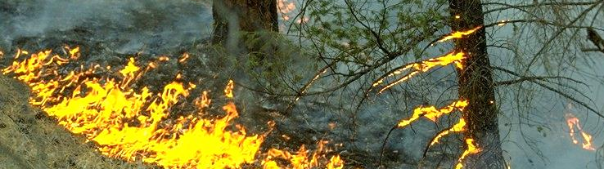
Areas available for Rx fire – summary of filters used
LANDFIRE Fire Regime Groups I, II and III, some IV
LANDFIRE burnable fuel models (not: FM91 urban/developed; FM92 snow/ice; FM93 agriculture; FM98 water; FM99 barren)
Riitters’ “Natural” vegetation 810m neighborhoods (NN, N, Nd, Na, Nad; this further excludes agriculture and developed dominated areas)
Forested and non-forested areas were mapped separately
F I L T E R S

Slide 20
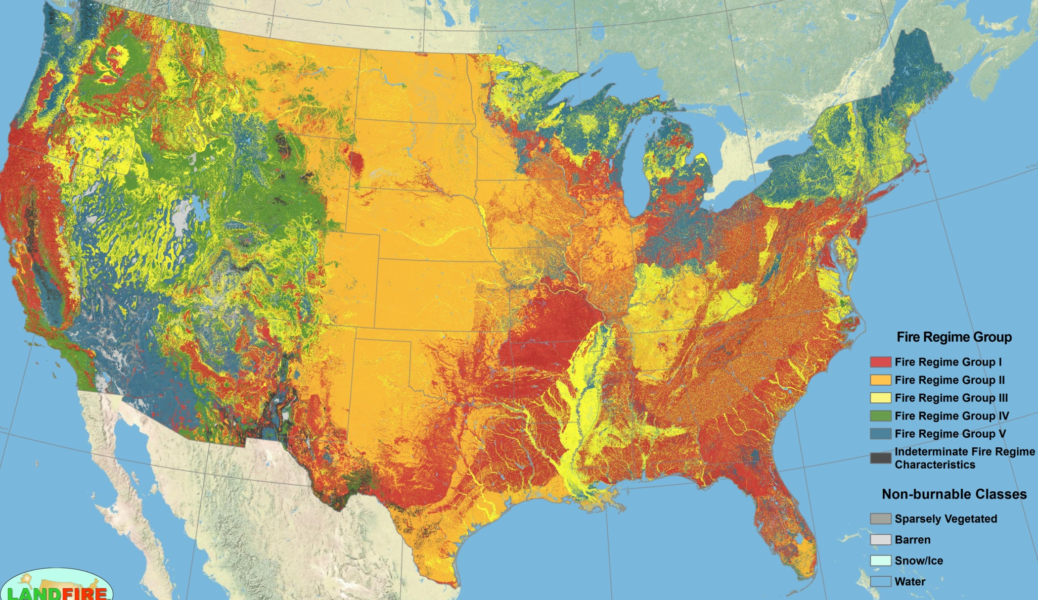
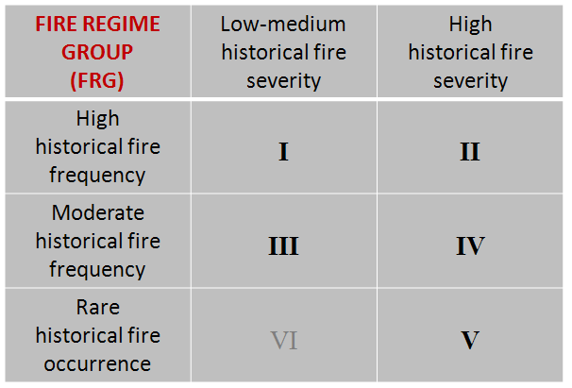
Areas available for Rx fire – Filter 1: Fire Regime Group
I
II
III
IV
Fire Regime Groups I – IV were included.
V

Slide 21
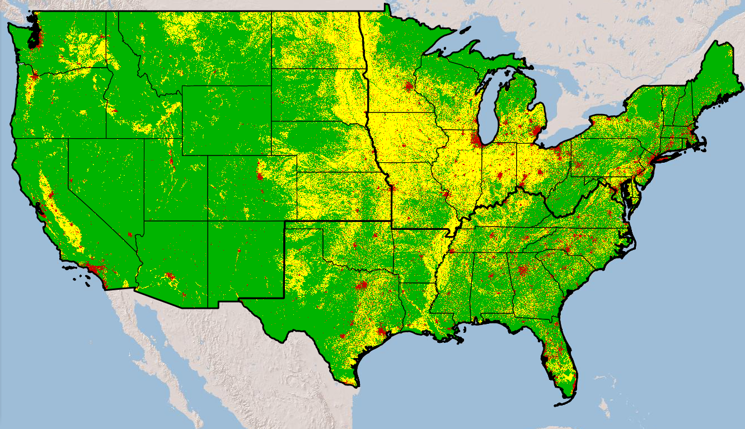
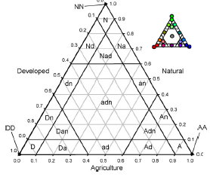
Areas available for Rx fire – Filter 3: “Natural” vegetation
Natural
Only Riitters’ Natural dominated groups were utilized.
Developed
Agric.

Slide 22
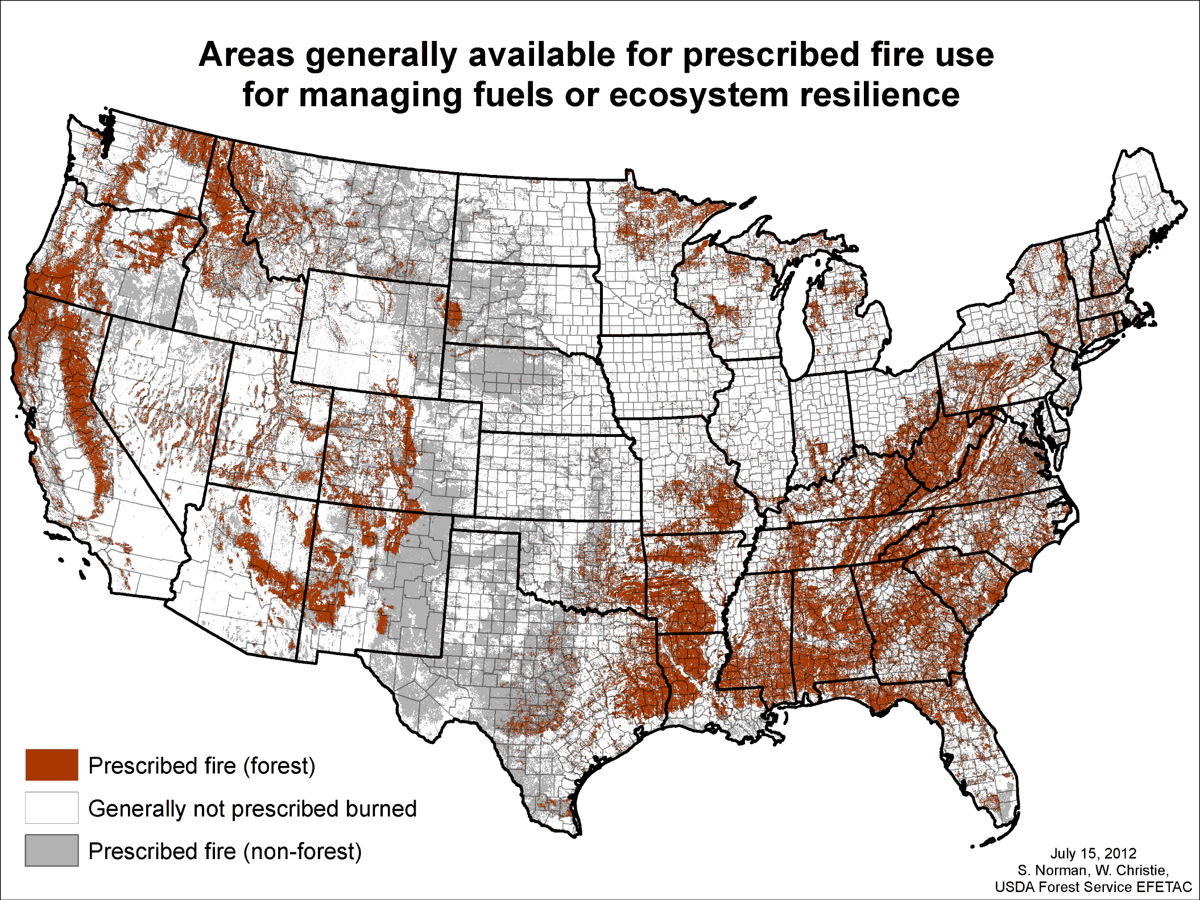
DRAFT

Slide 23
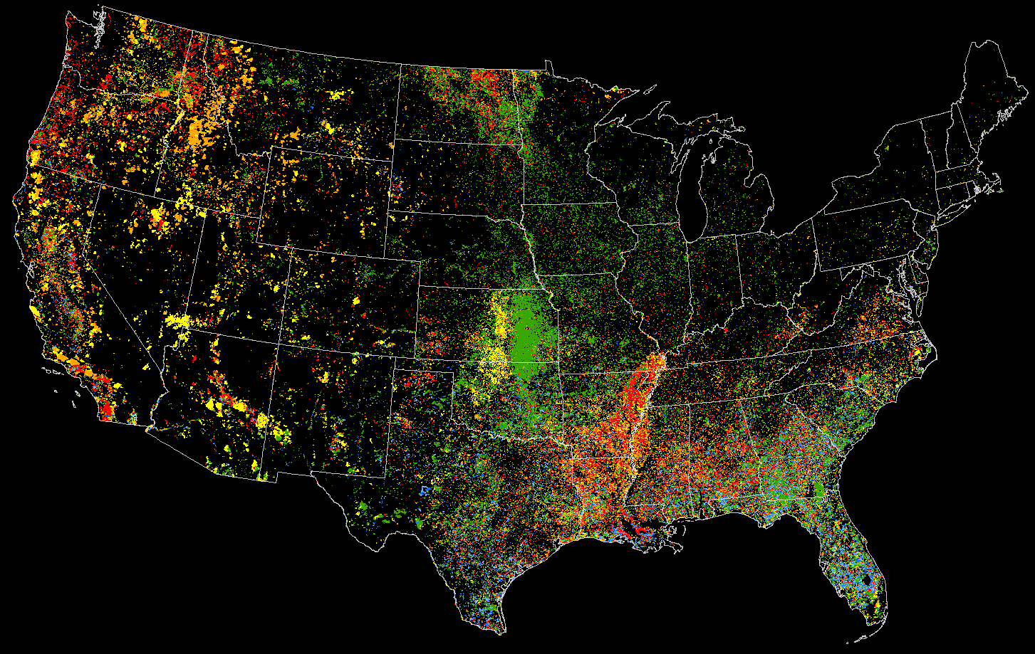

Seasonality of fire from space
as inferred from MODIS hotspots
2001-2011
Dec, Jan, Feb
Mar, Apr, May
Jun, Jul
Aug, Sep
Oct, Nov
N=1,009,782
Steve Norman 5/2012

Slide 24
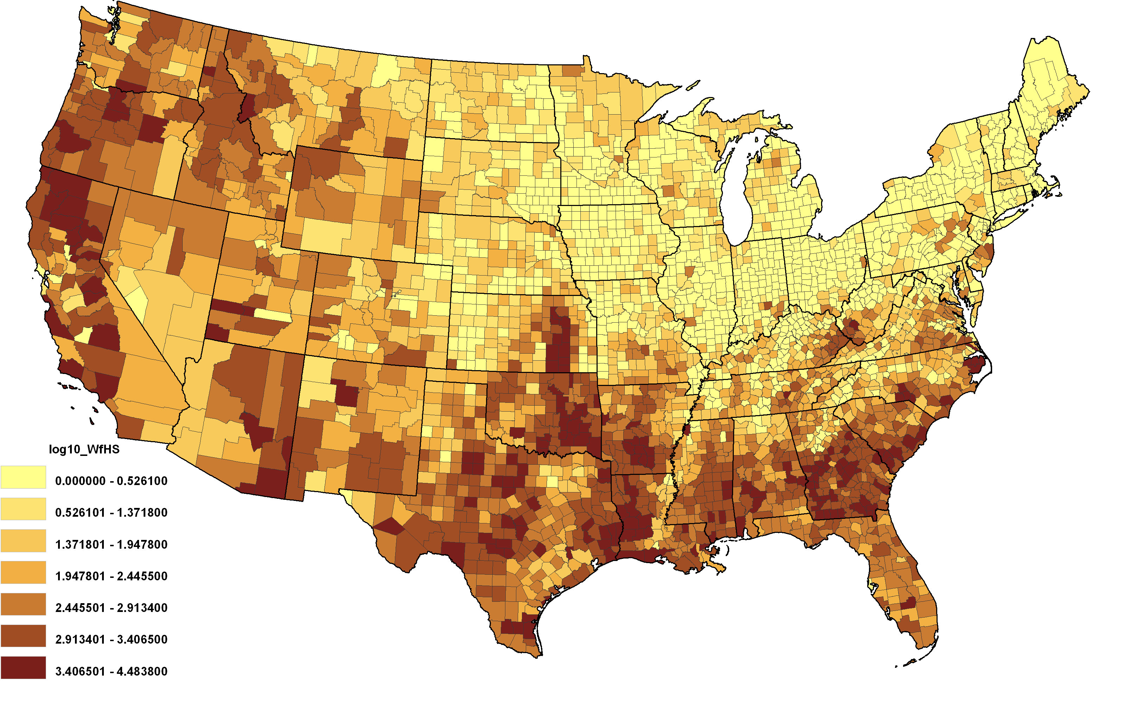
Hotspots assigned to wildfire (normalized by area)

Slide 25
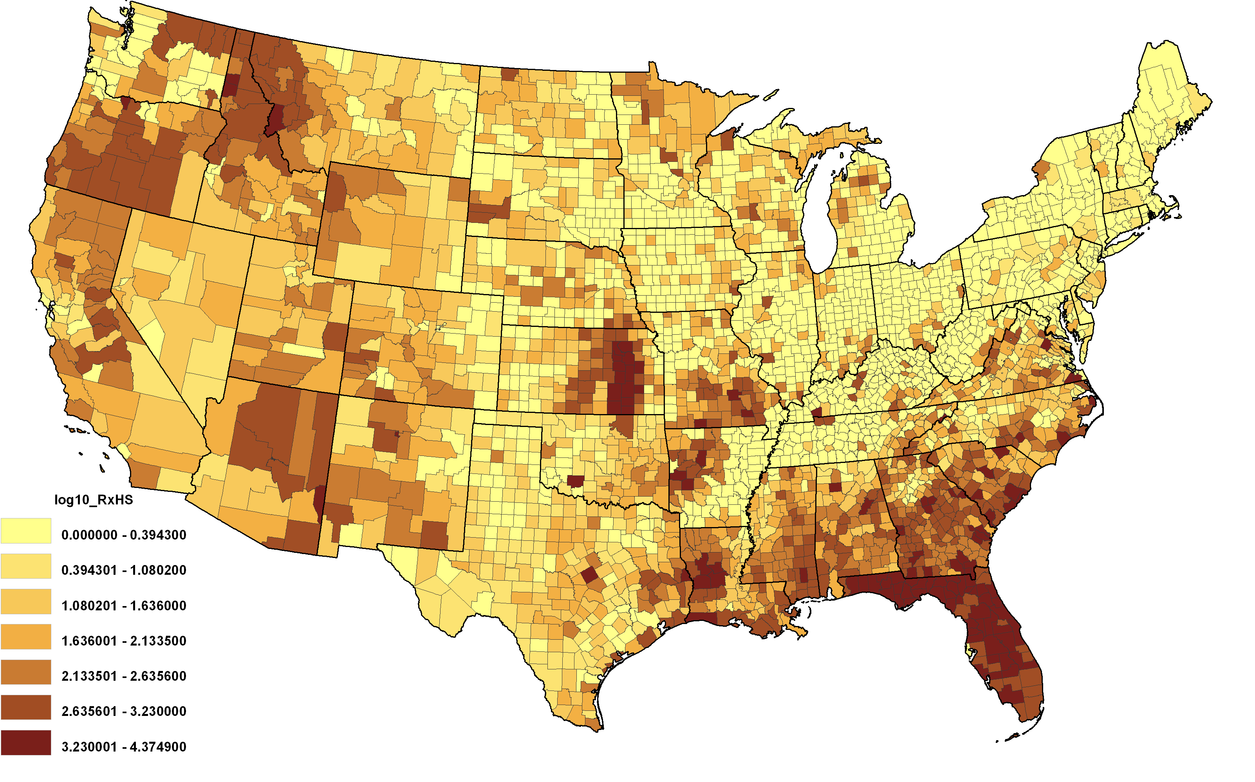
Hotspots assigned to prescribed fire (normalized by area)

Slide 26
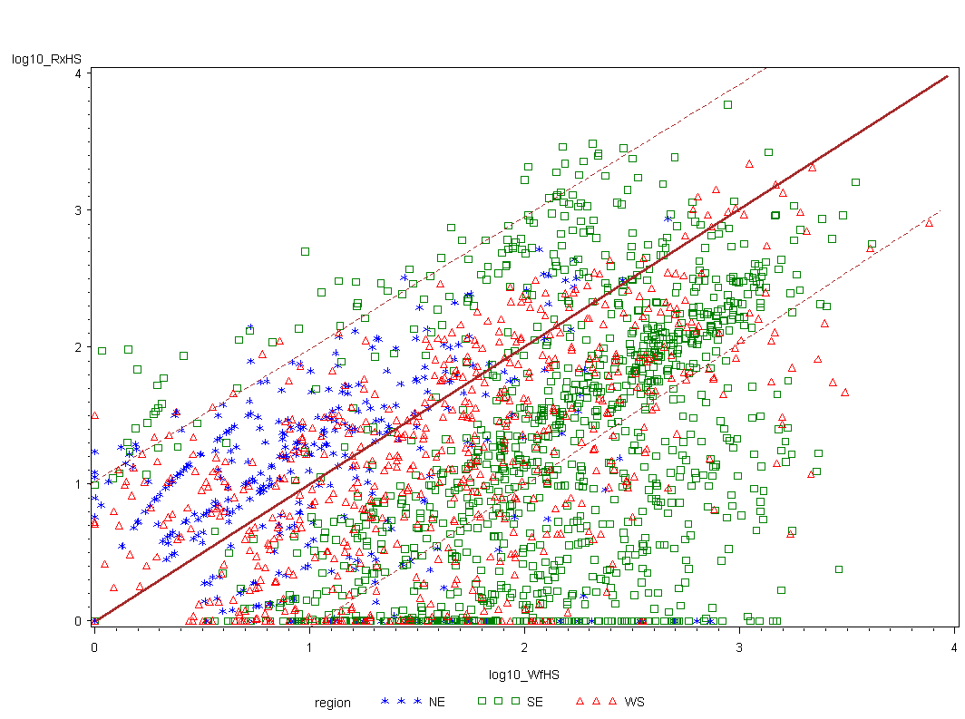
Prescribed Fire versus Wildfire based on hotspot density

Slide 31
Conclusions
Building on previous efforts, we’ve assembled a comprehensive, integrated set of data and models for informing discussions.
Built relationships among managers, stakeholders, scientists, and analysts that fosters trust and cooperation.
Lots of work remains.

Slide 32
Acknowledgements
Steve Norman
James Fox
Tom Quigley
Matt Thompson
Scott Goodrick
Jeff Prestemon
Jason Kreitler
Andy Kirsch
Darek Nalle
Karin Rogers
Alan Ager
Mark Finney
Dave Calkin
Mike Bowden
Sim Larkin
Sarah McCaffrey
Sue Stewart
…and many more

Slide 33
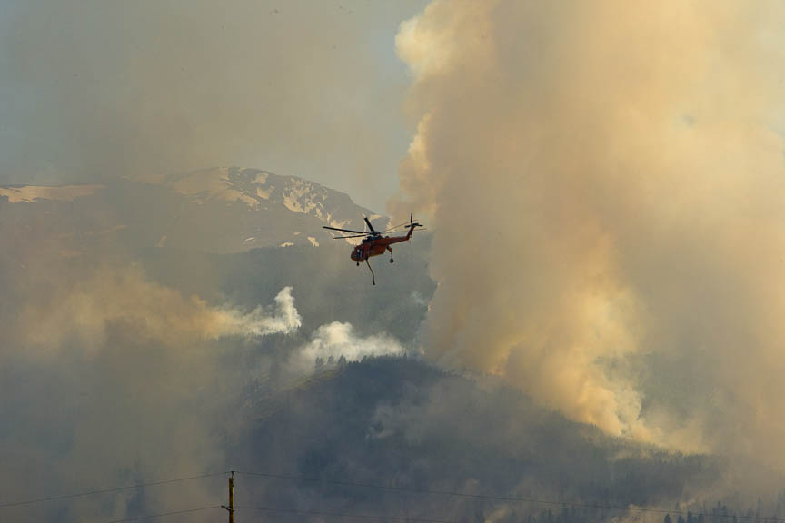
Questions?
For further information, visit http://www.forestsandrangelands.gov
or contact Judith Downing, jldowning@fs.fed.us
or Erin Darboven, Erin_Darboven@ios.doi.gov

